Slide 1
Chapter 21 Software quality metrics
Product metrics

Slide 2
Product metrics refer to the software system’s operational phase – years of regular use of the software system by customers, whether “internal” or “external” customers.
In most cases, the software developer is required to provide customer service during the software’s operational phase.
Customer services are of two main types:

Slide 3
Help desk services (HD) – software support by instructing customers
regarding the method of application of the software and solution of customer
implementation problems.
Corrective maintenance services – correction of software failures identified
by customers/users or detected by the customer service team prior to
their discovery by customers. The number of software failures and their
density are directly related to software development quality.

Slide 4
The array of software product metrics presented here is classified as follows:
■ HD quality metrics
■ HD productivity and effectiveness metrics
■ Corrective maintenance quality metrics
■ Corrective maintenance productivity and effectiveness metrics.
It should be remembered that software maintenance activities include:
■ Corrective maintenance – correction of software failures detected during regular operation of the software.
■ Adaptive maintenance – adaptation of existing software to new customers or new requirements.
■ Functional improvement maintenance – addition of new functions to theexisting software, improvement of reliability, etc.

Slide 5
HD quality metrics
The types of HD quality metrics discussed here deal with:
■ HD calls density metrics – the extent of customer requests for HD services as measured by the number of calls.
■ Metrics of the severity of the HD issues raised.
■ HD success metrics – the level of success in responding to these calls. A success is achieved by completing the required service within the time determined in the service contract.

Slide 6
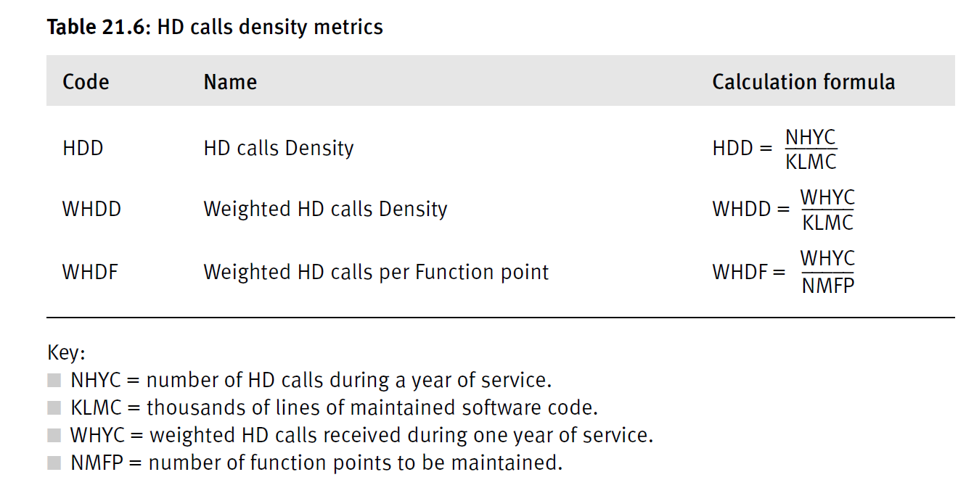

Slide 7
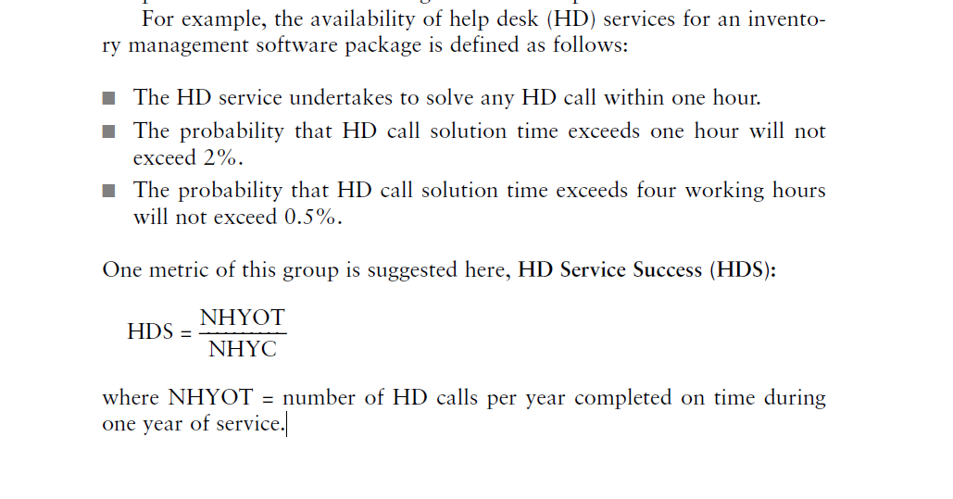
Success of the HD services The most common metric for the success of HD services is the capacity to solve problems raised by customer calls within the time determined in the service contract (availability).

Slide 8
software maintenance metrics are classified as follows: ■ Software system failures density metrics – deal with the extent of demand for corrective maintenance, based on the records of failures identified during regular operation of the software system. ■ Software system failures severity metrics – deal with the severity of software system failures attended to by the corrective maintenance team.
■ Failures of maintenance services metrics – deal with cases where maintenance services were unable to complete the failure correction on time or that the correction performed failed.
■ Software system availability metrics – deal with the extent of disturbances caused to the customer as realized by periods of time where the services of the software system are unavailable or only partly available.

Slide 9
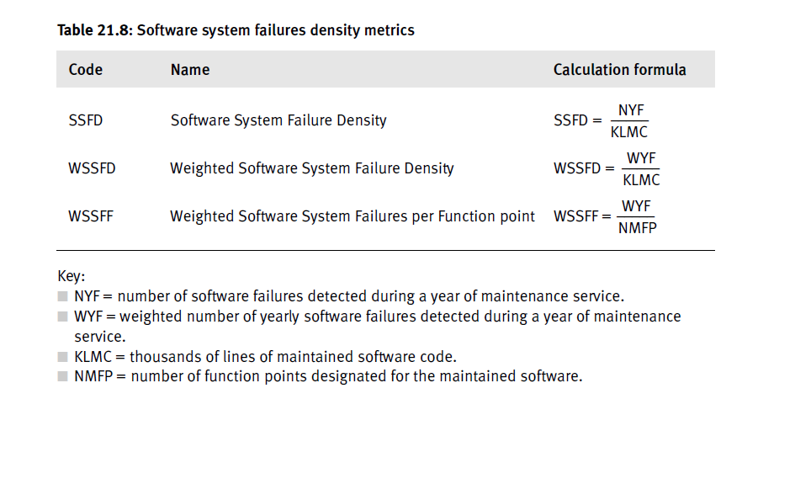

Slide 10
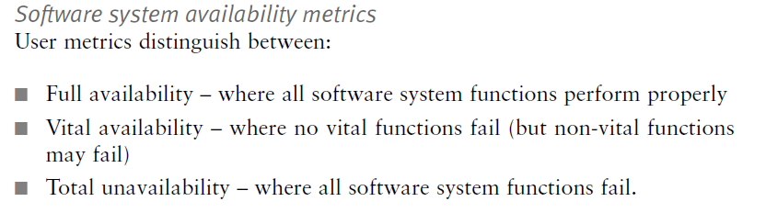

Slide 11
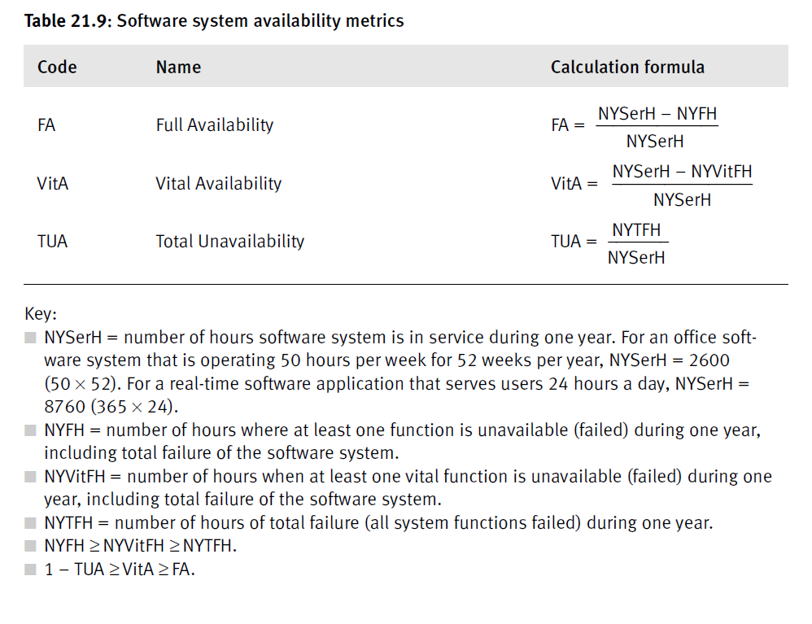

Slide 12
